Slide 1
GETTING STARTED
Introduction to Sprint Reviews

Slide 2
contents
introduction to sprint
conducting sprint reviews in
SECTION
₁ reviews
SECTION
₂ Easy Agile User Story Maps
what is a sprint review?
4
5
6
benefits of sprint reviews
show ‘done’ issues inspect and adapt
backlog grooming and refinement
9
anatomy of a sprint review guidelines for effective sprint review meetings
10
11
7

Slide 3
Introduction
To Sprint Reviews?

Slide 4
what is a sprint review?
A sprint review meeting takes place at the conclusion of a sprint, and reviews all of the ‘Done’ issues for that period. The aim of the sprint review is to see whether the goal for the sprint was achieved and to demonstrate potential shippable working product increments to the team.
Some of the activities that occur during the sprint review include:
The Product Manager/Owner walks through the ‘Done’ items from the Product Backlog
The Development team discusses what went well during the Sprint, the problems they ran into, and how they were solved/could be solved
The Development team demonstrates the work that they have “Done” and answer the teams
questions about the working increment
The team collaborates on what to do next, so that the Sprint Review provides valuable input into the subsequent Backlog Grooming and Sprint Planning sessions
Review of the timeline, budget, potential capabilities for the next anticipated release of the
product
Source: scrum.org

Slide 5

benefits of sprint reviews
Increases stakeholder engagement (early and frequent feedback)
Maximises responsiveness to customers
Team building and collaboration Updated and groomed backlog Updated release plan
Increased cross-team product understanding Increases the value of Sprint Planning meetings

Slide 6

















anatomy of a sprint review
External Stakeholders
Internal Stakeholders
V
Scrum Team
Inputs
Sprint Goal
Sprint Review
Overview of ‘Done’ issues and backlog discussion
Outputs
Groomed product backlog
Sprint Backlog
As an iTunes user I want to redeem my gift card so that I can claim my credit | ATV-121
As a user I want to find movies easily so that I save time browsing long lists | ATV-111
As a user I want to be able to fast forward movies so that I skip scary parts of the film | ATV-145
As a user I want to be able to save my favourite movies to a list so that I can watch them later | ATV-345
As a user I want to use Paypal as my preferred payment method so that I feel safe about my transactions | ATV-345
As an iTunes user I want to redeem my gift card so that I can claim my credit | ATV-121
As a user I want to find movies easily so that I save time browsing long lists | ATV-111
As a user I want to be able to fast forward movies so that I skip scary parts of the film | ATV-145
As a user I want to be able to save my favourite movies to a list so that I can watch them later | ATV-345
As a user I want to use Paypal as my preferred payment method so that I feel safe about my transactions | ATV-345
As an iTunes user I want to redeem my gift card so that I can claim my credit | ATV-121
As a user I want to find movies easily so that I save time browsing long lists | ATV-111
As a user I want to be able to fast forward movies so that I skip scary parts of the film | ATV-145
As a user I want to be able to save my favourite movies to a list so that I can watch them later | ATV-345
As a user I want to use Paypal as my preferred payment method so that I feel safe about my transactions | ATV-345
Demonstration of potentially shippable product increment
Updated release plan
Potentially shippable product increment
adapt
inspect
Source: Kenneth S. Rubin and Innolution

Slide 7




guidelines for effective sprint review meetings
Focus on ‘Done’ Issues: focus on acceptance criteria that had met the Definition of Done (DoD)
Meeting format: the meetings should be informal; not a reporting exercise, rather an opportunity to get together and give feedback. Time box the meeting in accordance with the following:
week sprint = 1 hour
week sprint = 2 hours
4 week sprint = 4 hours
Focus on the user: centre any demonstrations around a realistic user experience and business value (not just proving functionality)

Slide 8
Conducting Sprint Reviews in Easy Agile User Story Maps

Slide 9
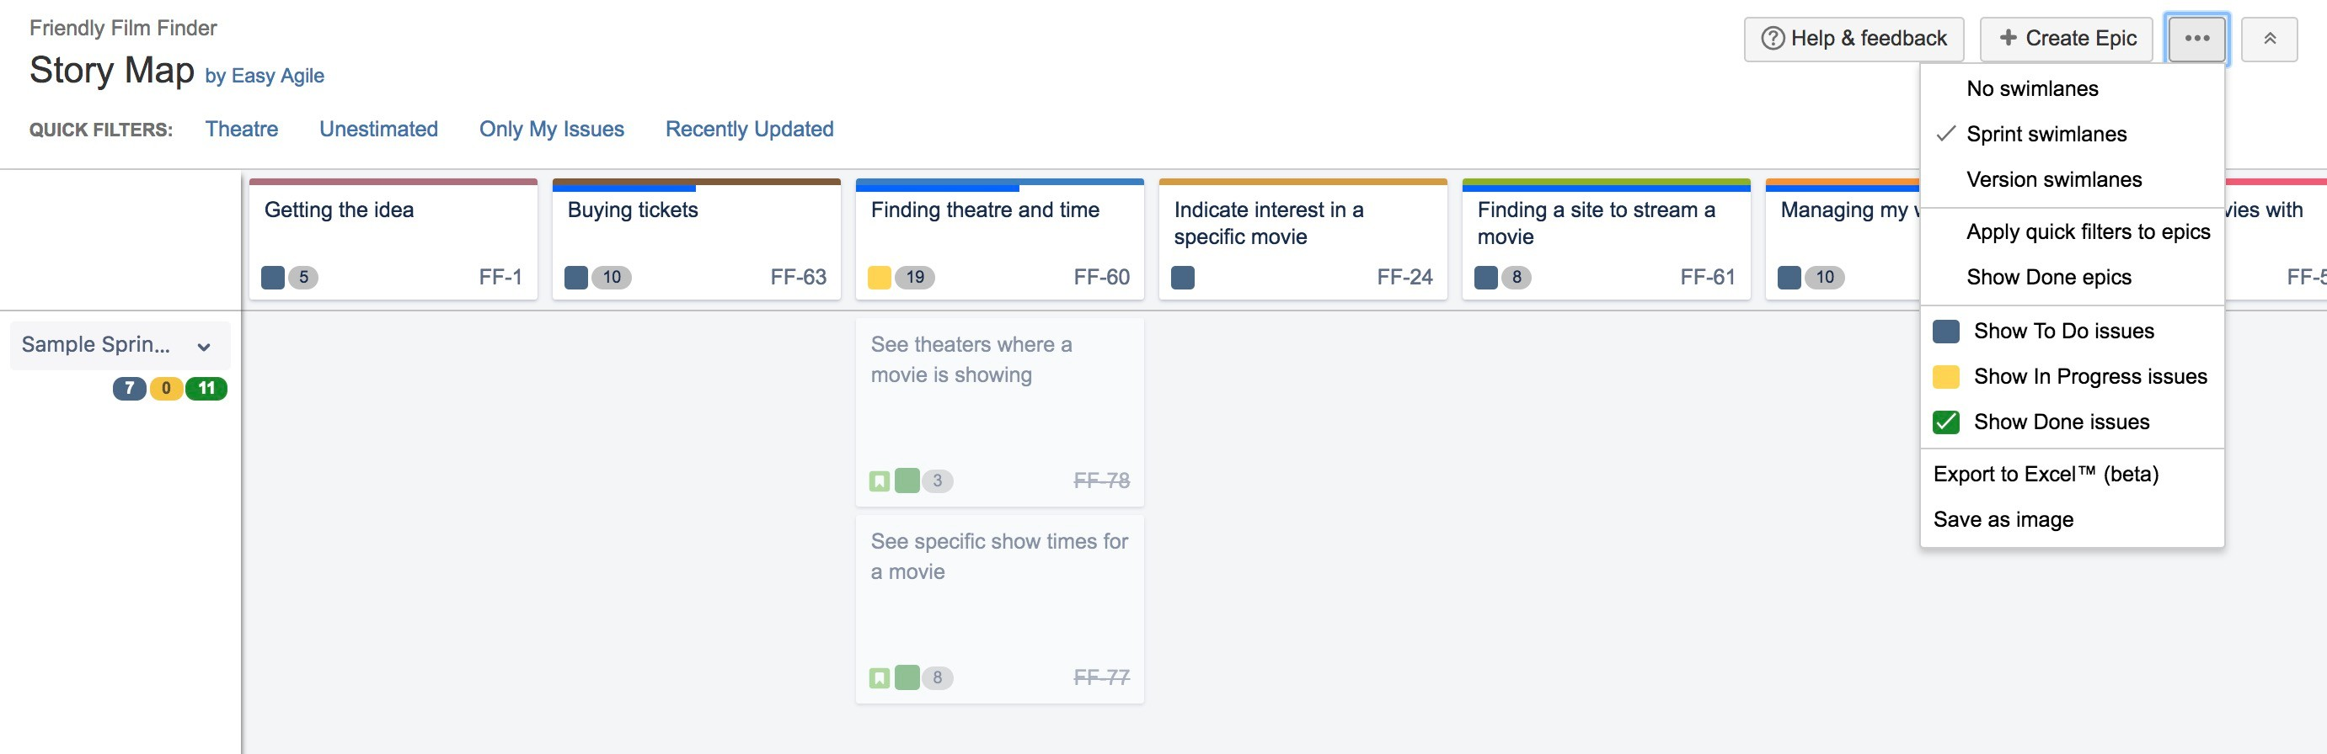
show ‘Done’ issues
Showing ‘Done’ Issues
Filtering the story map to only show ‘Done’ issues allows teams to conduct their Sprint Review Meetings quickly and collaboratively inside of the Story Map

Slide 10

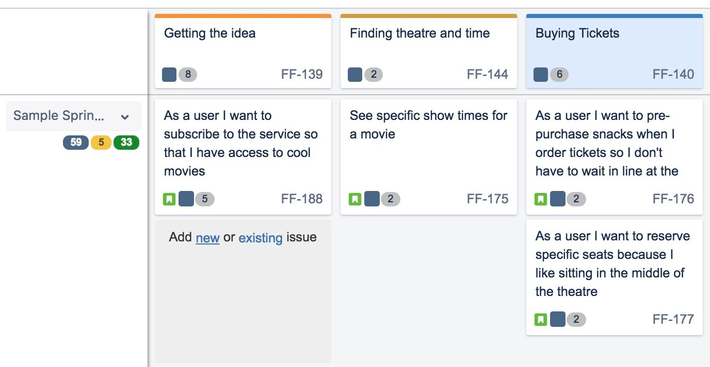
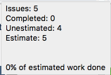
inspect and adapt
Sprint Statistics
reviewing your teams forecasted sprint statistics against the result of the actual sprint helps teams track work commitment, and ensure work continues at a sustainable pace

Slide 11
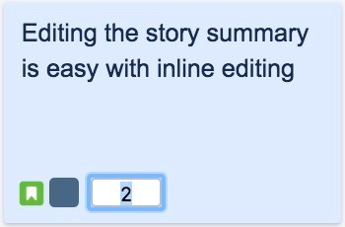
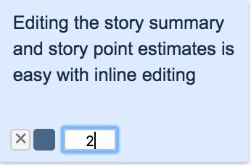
backlog grooming and refinement
Inline Edit Story Point Estimates
after reviewing the forecasted sprint statistics against the actuals, teams can inline edit and update story point discrepancies for upcoming stories, keeping the product backlog healthy and updated

